Slide 1

Theatre Royal Booking Application
Technical Presentation

Slide 2
Project Management
Break down requirements pdf into concise specifications and milestones
Use of Trello to manage task allocation and monitor progress against milestones
Use of GitHub and branching for source and version control
Slack for communication
Different channels representing each aspect so questions, queries, and ideas remained focussed

Slide 3
Application Design Process
Produce class diagram
Initially containing just responsibilities
Initial database design
Java class diagram then fleshed out with greater detail
Database then developed to support the Java application design
Backend developed with dummy data while database was completed
Frontend developed after
Test Driven Development

Slide 4
Program Flow
On first run, a temporary UserID is created and assigned
When adding an item to a bakset this UserID is used to identify the current user when retrieving the basket later in the session
Basket items are deleted after n number of minutes by the database
When a user completes a checkout, their UserID is flagged as permanent and their details stored
Database has functionality to allow for user login at a later date (future update)

Slide 5
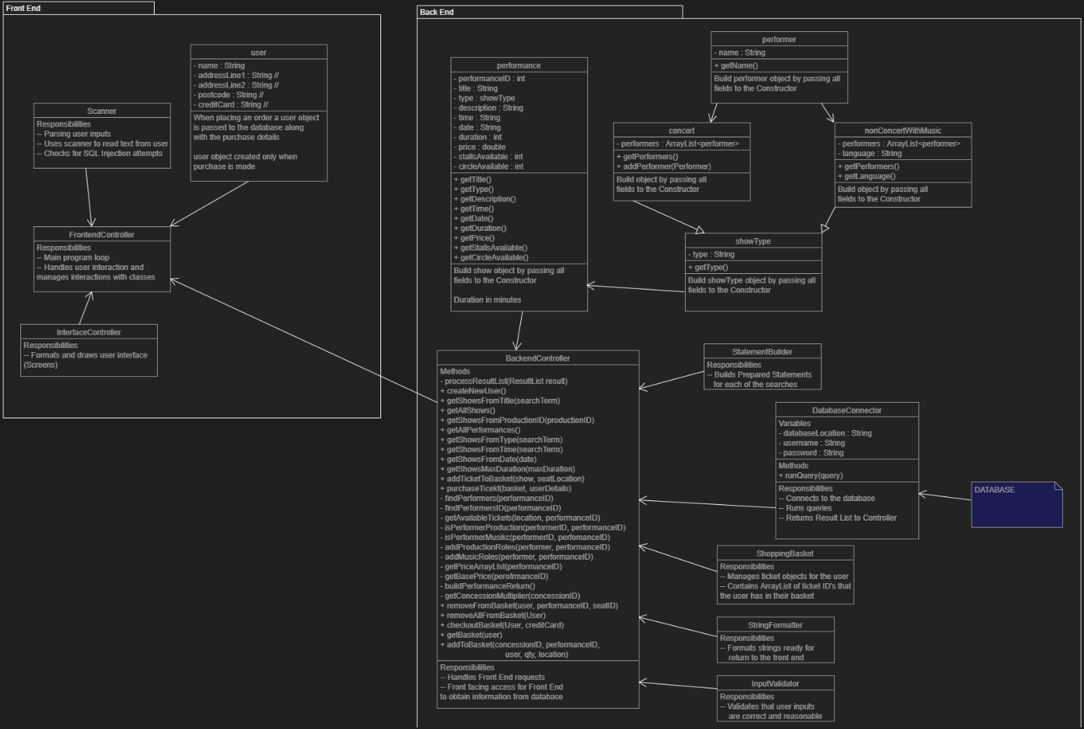

Slide 6
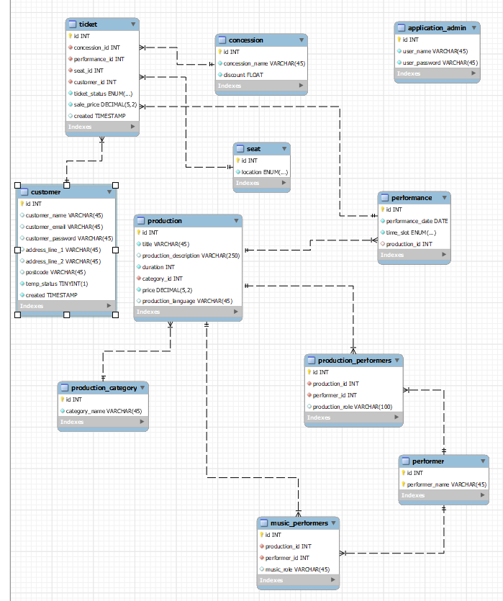

Slide 7
Backend Development
Provide a front facing Interface for the front end
Handle queries of the SQL database
Use of a StatementBuilder to use Prepared Statements to complete pre-prepared statements to protect against SQL Injection
Validate user inputs

Slide 8
Database Development
SQL Events to remove unpurchased tickets
Runs every 5 minutes
Removes tickets which are over 5 minutes old
Database maintains accurate baskets for all users

Slide 9
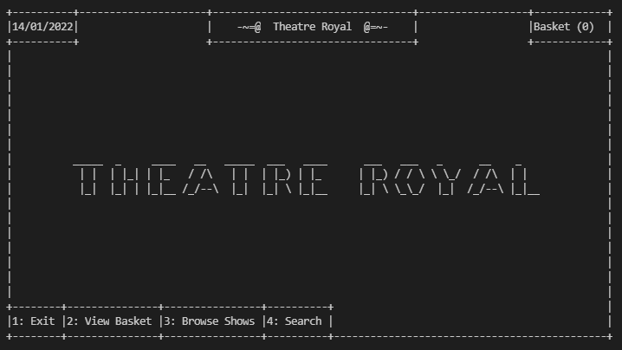
Frontend Development
Primary user interface
Search for shows
From date
Show title
Browse
Show information
Performers
Prices
Multiple tickets
Different shows in the same order

Slide 10
Test Driven Development
Searches and SQL queries were put together within MySQL Workbench on a test Database with known results
Query moved into Java, and then tested with a BackendTester class
BackendTester was used to pull raw data from the Backend and simulate a Frontend making a request without having to consider formatting or presentation
UnitTests were used for the development of the UserValidation and String formatting aspects of the project

Slide 11
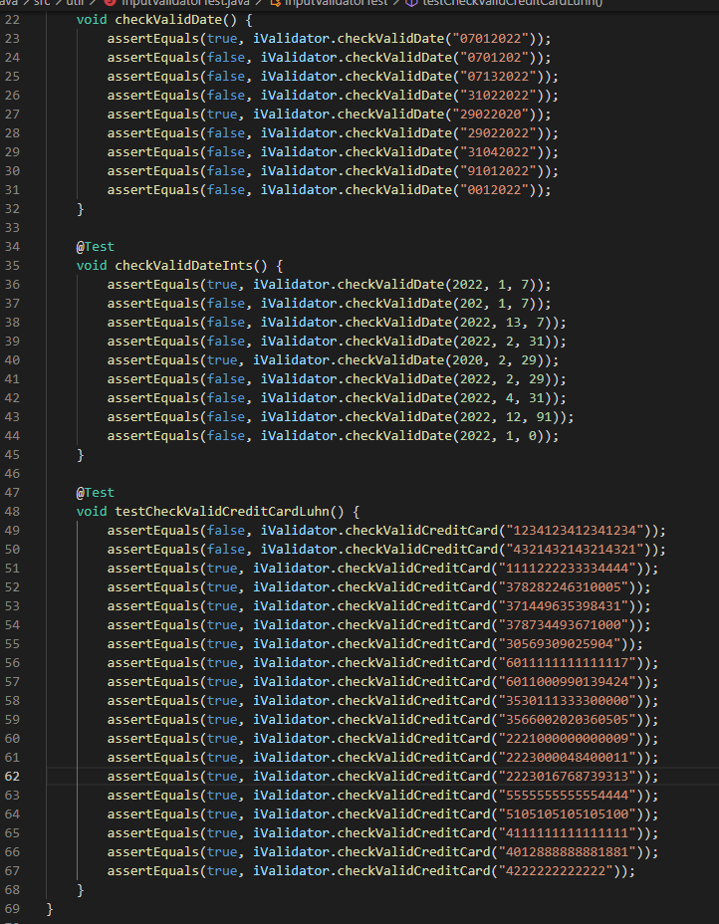
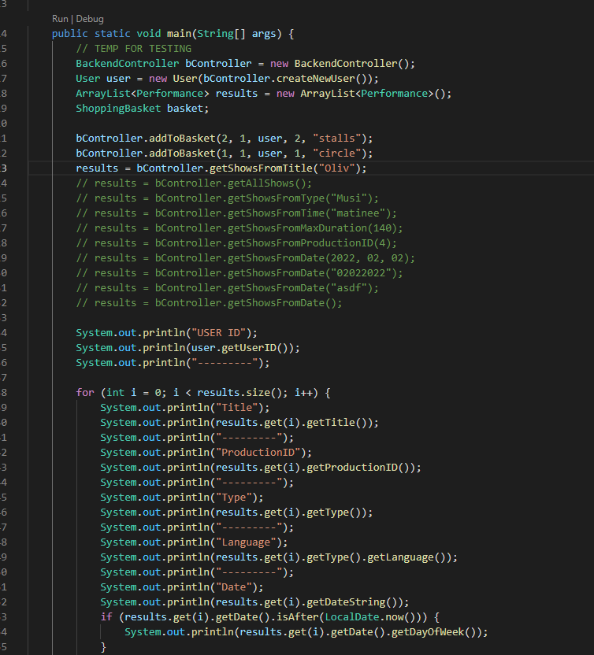
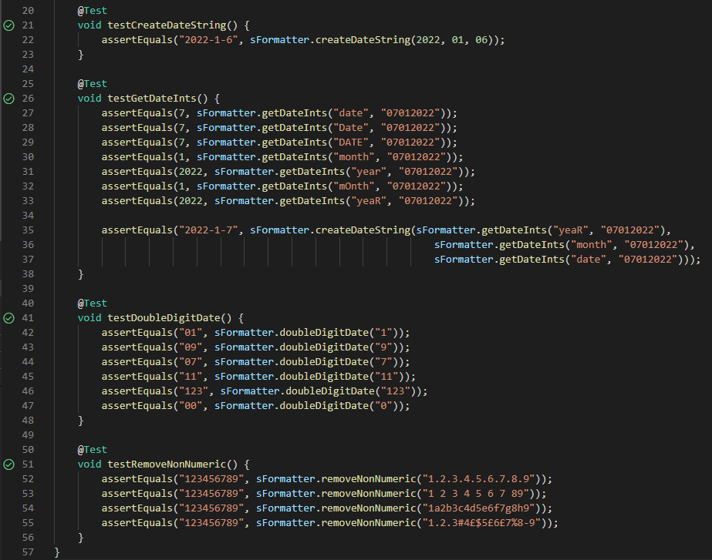

Slide 12
Exception Handling
Backend provides FrontEnd with an ArrayList of Perofmance objects when requested
Backend never returns a null object, instead if a search is invalid an Empty ArrayList is returned
No exceptions from erroneous searches, PreparedStatements prevent from type mismatches
Empty search results are displayed instead of an application crashing

Slide 13
Test and Debug
Unused Branch made for each milestone
Live test and demo of application on a Slack call prior to milestone being agreed as complete
Bugs found were first replicated then debugged using debugging tools (Stepping through and into the code, and using Watches)

Slide 14
Challenges and Improvements
Basket was managed in the database, by inserting a record with a basket flag into the tickets table
Retrieving a basket queried the database to obtain basket tickets for a given UserID
Difficult to balance performance and Basket integrity
With a standalone backend being connected to multiple clients. Baskets could be handled entirely by the backend minimising database queries
Backend could allocate seats in bulk so all seats are together
Update all timestamps for the basket items when adding an item to prevent early basket timeout
Browse shows could have it’s own list box which only shows general show information, not specific information such as seat availability etc
Checkout confirmation message
Basket contents should show the names of the shows of the respective quantities

